Slide 1
Webex Contact Center Analyzer Reporting

Slide 2
Agenda
1. Analyzer Overview
2. Creation of visualizations
3. Analyzer Scheduler
4. Stock reports
5. Dashboards
6. Q&A

Slide 3

Analyzer Overview

Slide 4
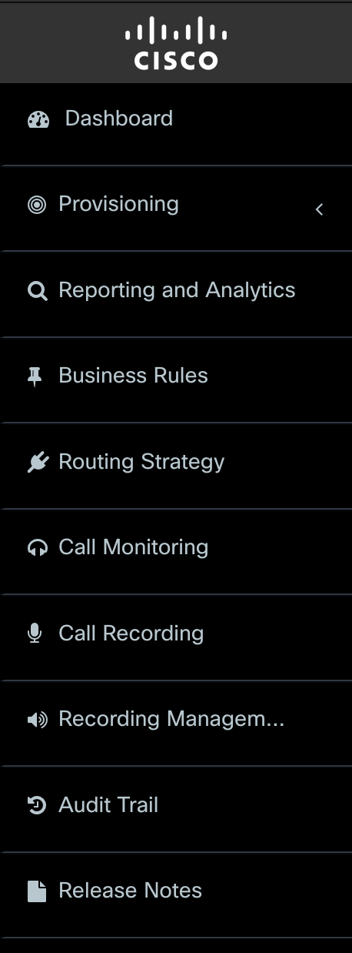
Portal Overview
Dashboard - Enables authorized users to create, view, and edit the settings that are provisioned for the enterprise. It provides access to Audit Trail, Agent Skill Report, Provisioned Items Report, and Provisioned Skills Report.
Provisioning – The provisioning dropdown provides the majority of Webex Contact Centre configuration apart from adding Users and Web Chat configuration , which are done within the Control Hub. Each of the drop-down menu items are described in this document.
Reporting and Analytics - module that enables authorized users to segment, profile, and visualize the data in contact centre systems. It also helps to identify the key variables that impact productivity and desired business outcomes.
Business Rules - Enables authorized users of the Analyzer module to incorporate customer data into the Webex Contact Centre environment for custom routing.
Routing Strategy - Provides a web-based user interface for managing and configuring contact handling strategies. Authorized users can create and schedule global routing and team capacity strategies and alter them in real time in response to changes in business dynamics.
Call Monitoring- Enables authorized users to silently monitor the quality of service being delivered across their multi-source contact centres. The power of the Webex Contact Centre service lies in the unique ability to monitor any call across any site. Through a simplified web interface, users can select the queue, team, site, or agent they want to silently monitor. Authorized users can provide instructions to the monitored agent without being heard by the caller and can join a call being monitored and participate in the conversation.
Call Recording - Optional module that enables authorized users to record calls.
Call Recording Manager - Optional module that enables authorized users to search for and play calls recorded through the Webex Contact Centre Call Recording feature
Audit Trail - Enables authorized users to view details about provisioning changes made for their enterprise and export the data to a data analysis tool, such as Microsoft Excel.
Release Note - Enables authorized users to view and download release notes

Slide 5
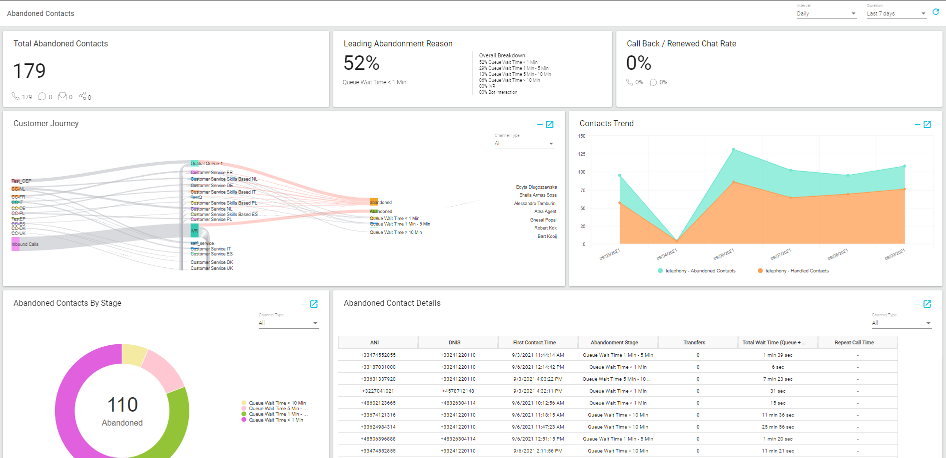
What it offers?
Native Cloud reporting platform for Webex CC
Stores Customer Interaction & Agent Activity records
Historical & Real-time reports/Dashboards
Customized visualizations and dashboards
Schedule reports
Supports Chart & tabular reports
Export report as .CSV & Excel to do further analysis
Dashboard Capabilities for single view of multiple Historical and Real-time reports

Slide 6
Portal Access
Access using Cross Launch From Webex Contact Center Management Portal: https://portal.wxcc-eu1.cisco.com/
Access using using Direct Link: https://analyzer.wxcc-eu1.cisco.com/analyzer/home

Slide 7
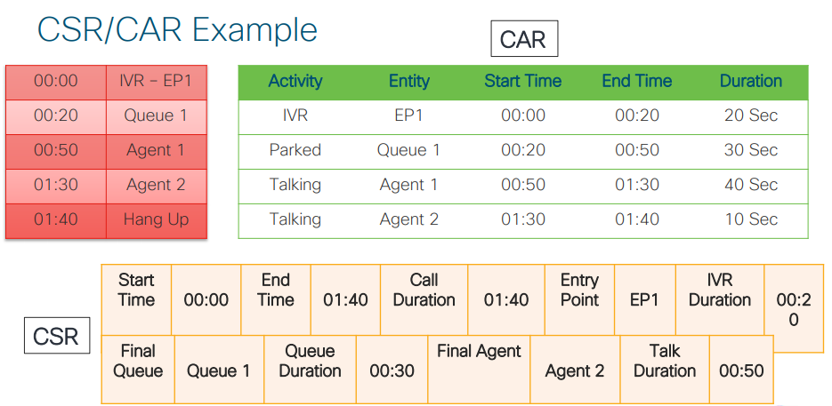
Analyzer Record Type – CSR/CAR
Choose the record type of the visualization:
• Contact Activity Records (CAR): Represents an individual step in the customer workflow.
• Contact Session Records (CSR): Represents the customer workflow, consisting of a sequence of customer activities.

Slide 8
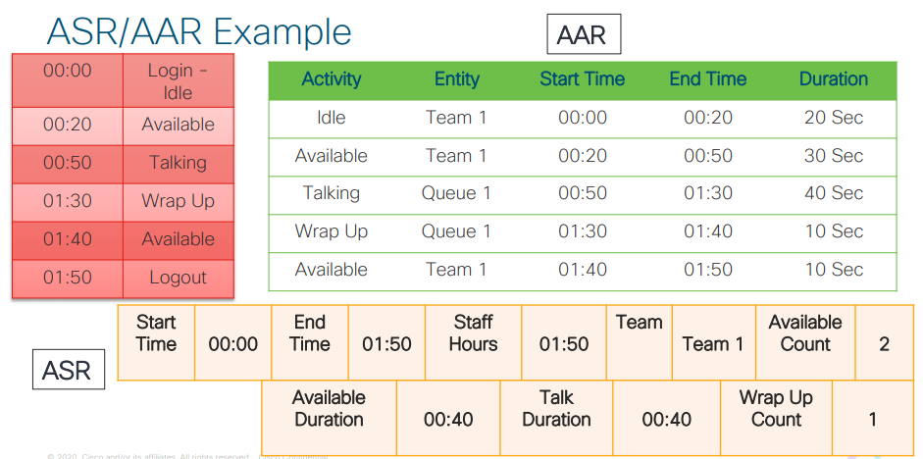
Analyzer Record Type – ASR/AAR
Choose the record type of the visualization:
• Agent Activity Records (AAR): Represents an individual step in the agent workflow.
• Agent Session Records (ASR): Represents the agent workflow, consisting of a sequence of agent activities.

Slide 9

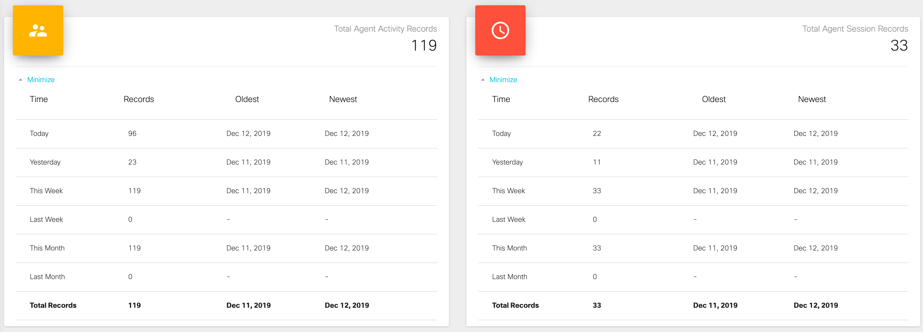
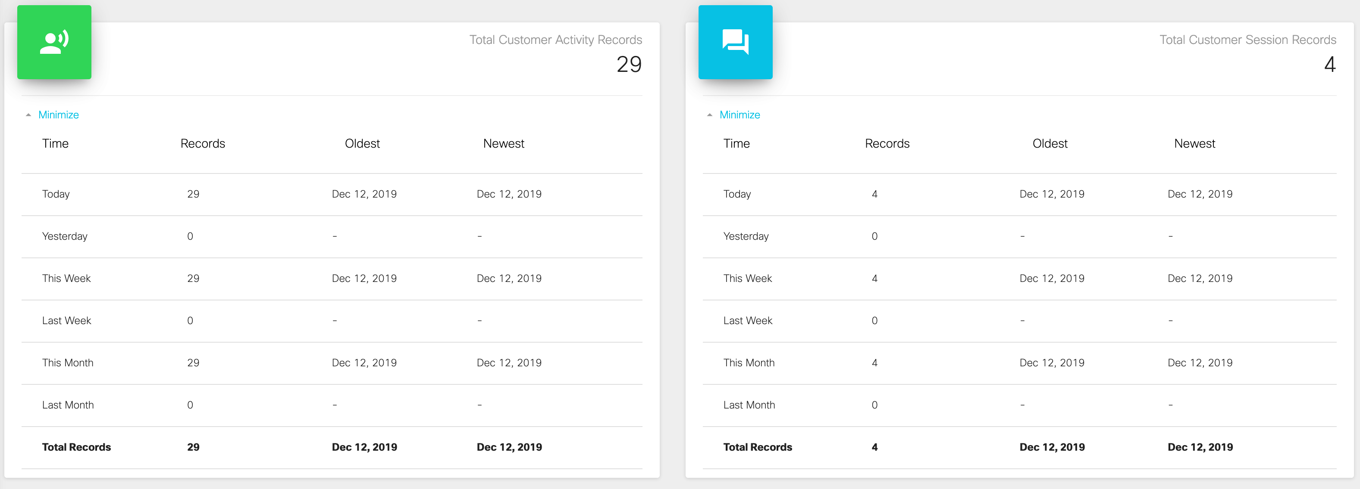
Home

Slide 10
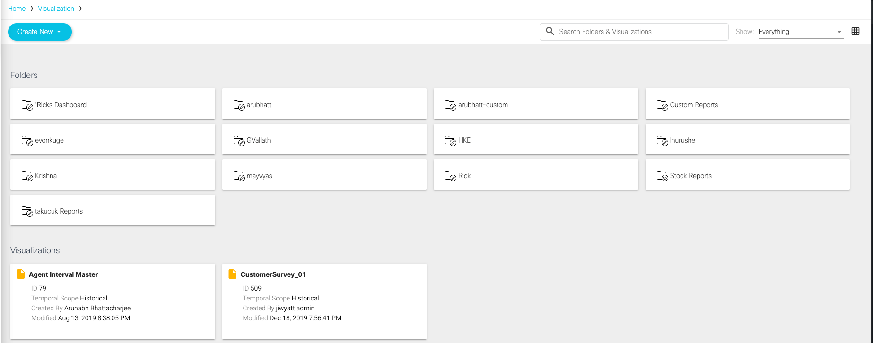

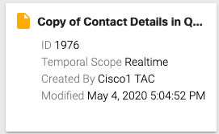
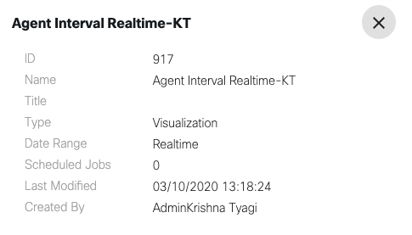
Navigation
Visualizations, Dashboards and Variables
By default, you will only have Stock Reports
You can access to these stock reports or create new customized ones
Search Folder and Visualizations
2 types of views: List or Grid
Visualization Summary
Temporal Scope
Created By
Modified Date/Time
Click on Details for more info

Slide 11

Creation of custom visualizations

Slide 12
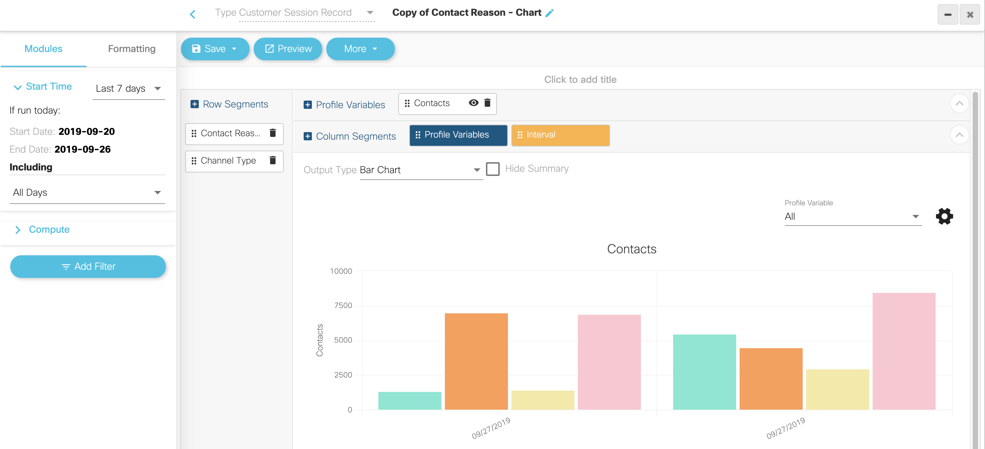
Creation of Visualizations Overview
Name and Type of visualization
Save and Preview buttons
Column definition
Row segmentation
Attributes
Output chart preview

Slide 13


Create Visualization
Structure
Type or Repository: CSR, CAR, ASR, AAR
Time Period: Realtime or Historical
Interval
Output Type: Table, Heatmap, Chart
Defines the data set
Profile Variables:
Field, Measures and Formulas
Value or Count Report
Row Segment
Fields, Enhanced Fields
Filter
Fields, Measures

Slide 14

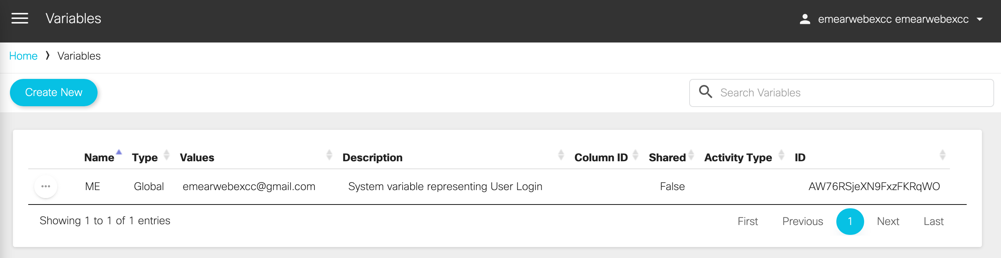
The Analyzer
Demo
Variables
You can create a variable that consists of an array of values.
For example, if you have x number of agents, then you would have to create x copies of a report (one for each agent) with the required data. Instead, you can use variables to create a single report with the required data.
You can use these variables while creating profile variables and row segments.

Slide 15
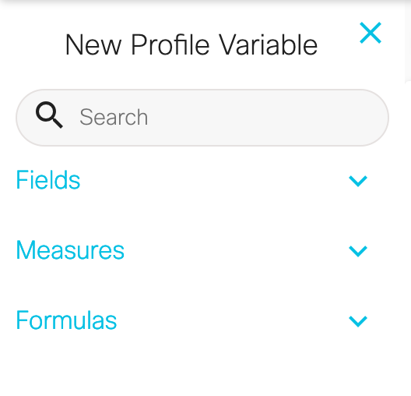
Visualization Variables

Slide 16
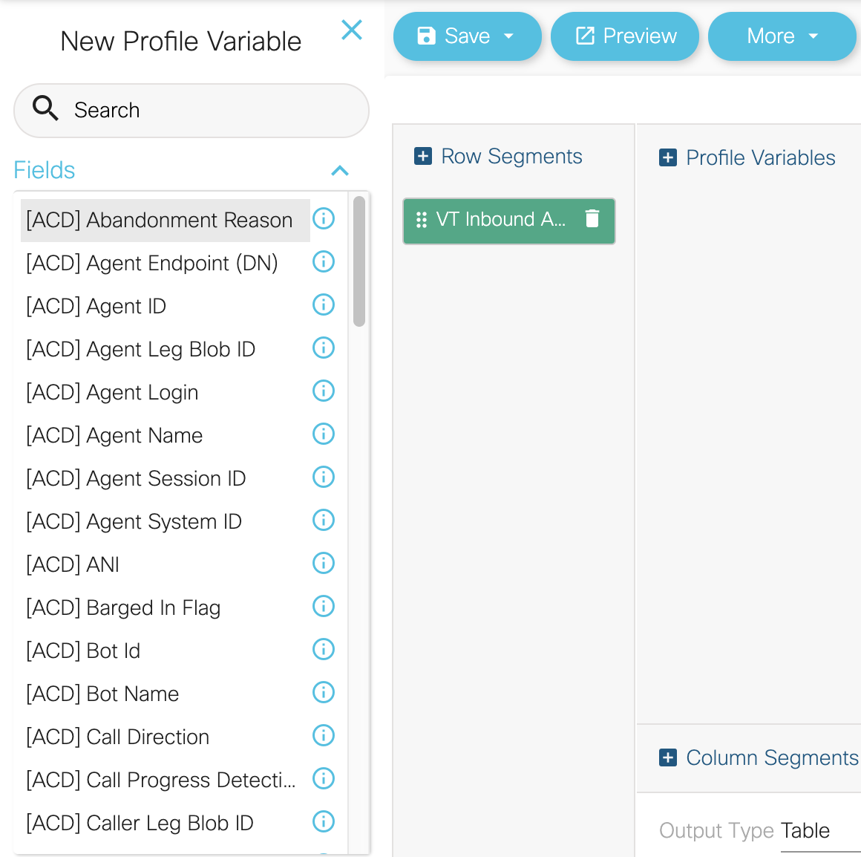
Fields
Only fields can be used for segmentation as shown.
- They are only textual values.
Fields can be combined with measures to create specific conditions for profiling variables.
DNIS, EntryPointName, QueueName and AgentName are all fields.
The order of the fields can be changed by dragging them to another position.
Remove a field by clicking the X that shows up on the field on the canvas when the mouse pointer is over it.

Slide 17
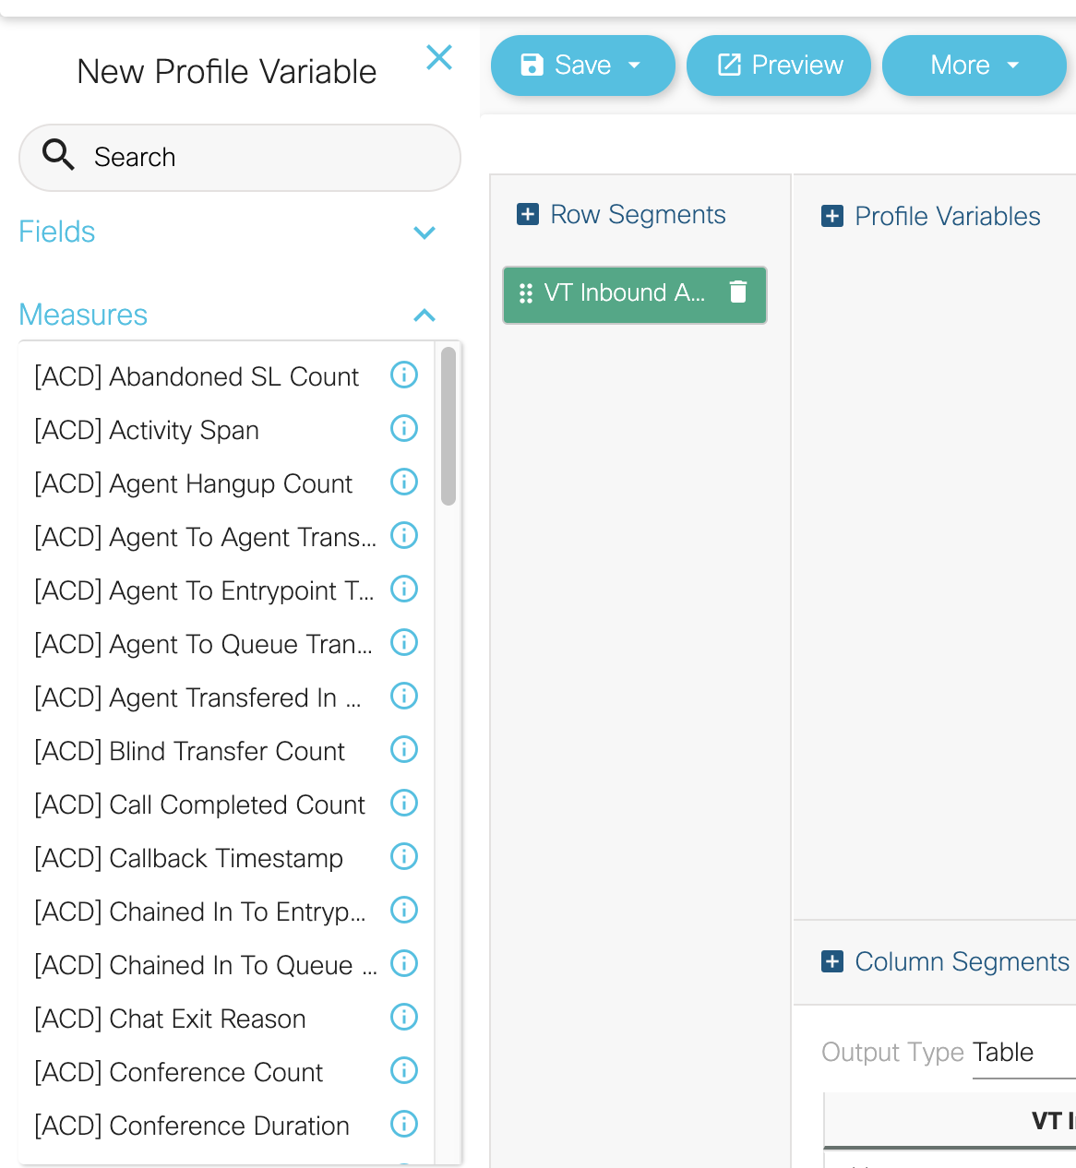
Measures
Measures are computed values that are predefined in the data dictionary.
They can only be used for profile variables.
Remove measures the same way as a field and drag to change the location or order of the measures.
Measures can also be defined as a range (ex. ItemShipped between 50-100).

Slide 18
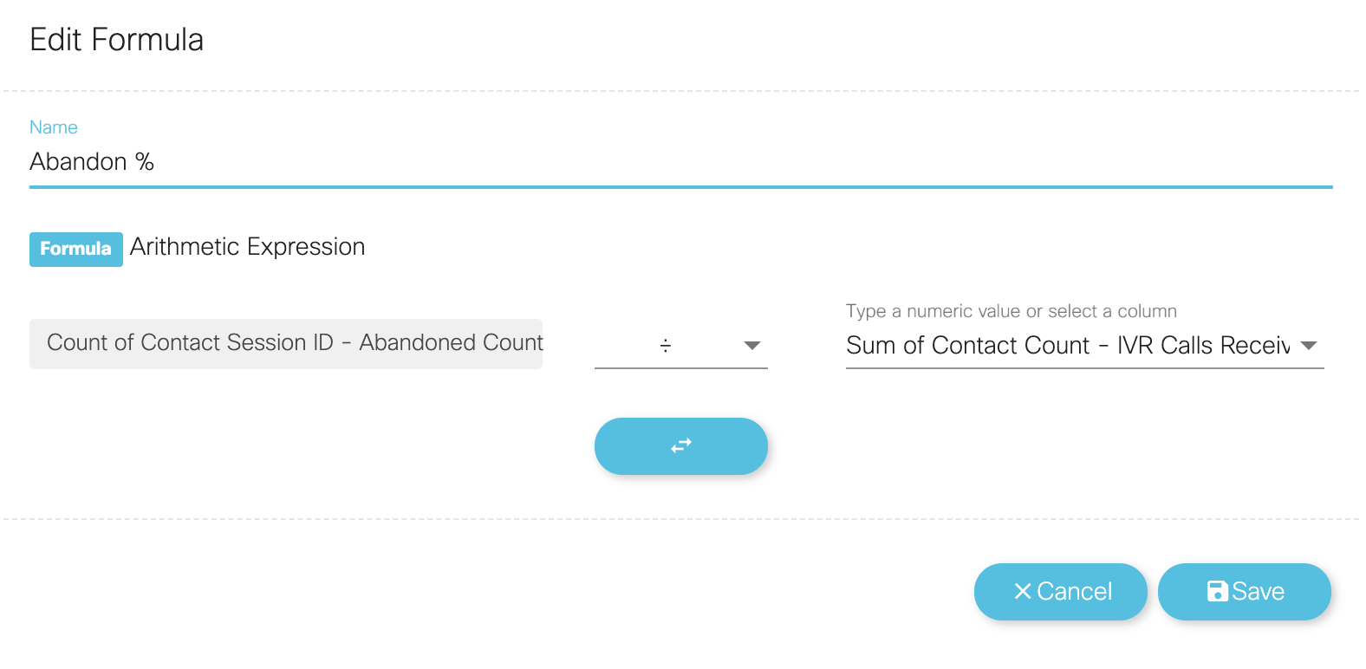
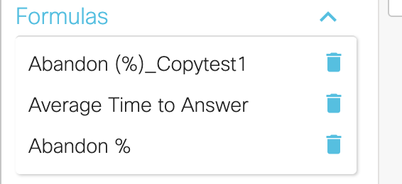
Formulas
The user can create formulas with an existing profiling variable or with a new profiling variable.
Right click an existing PV and
click new profile variable.
Formulas can only have one resultant profiling variable.
Custom Formulas can be saved and reused across the Analyzer

Slide 19
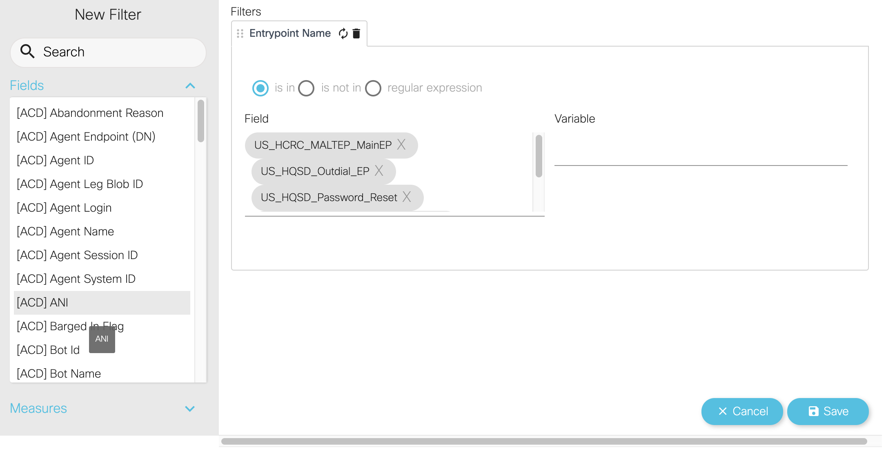
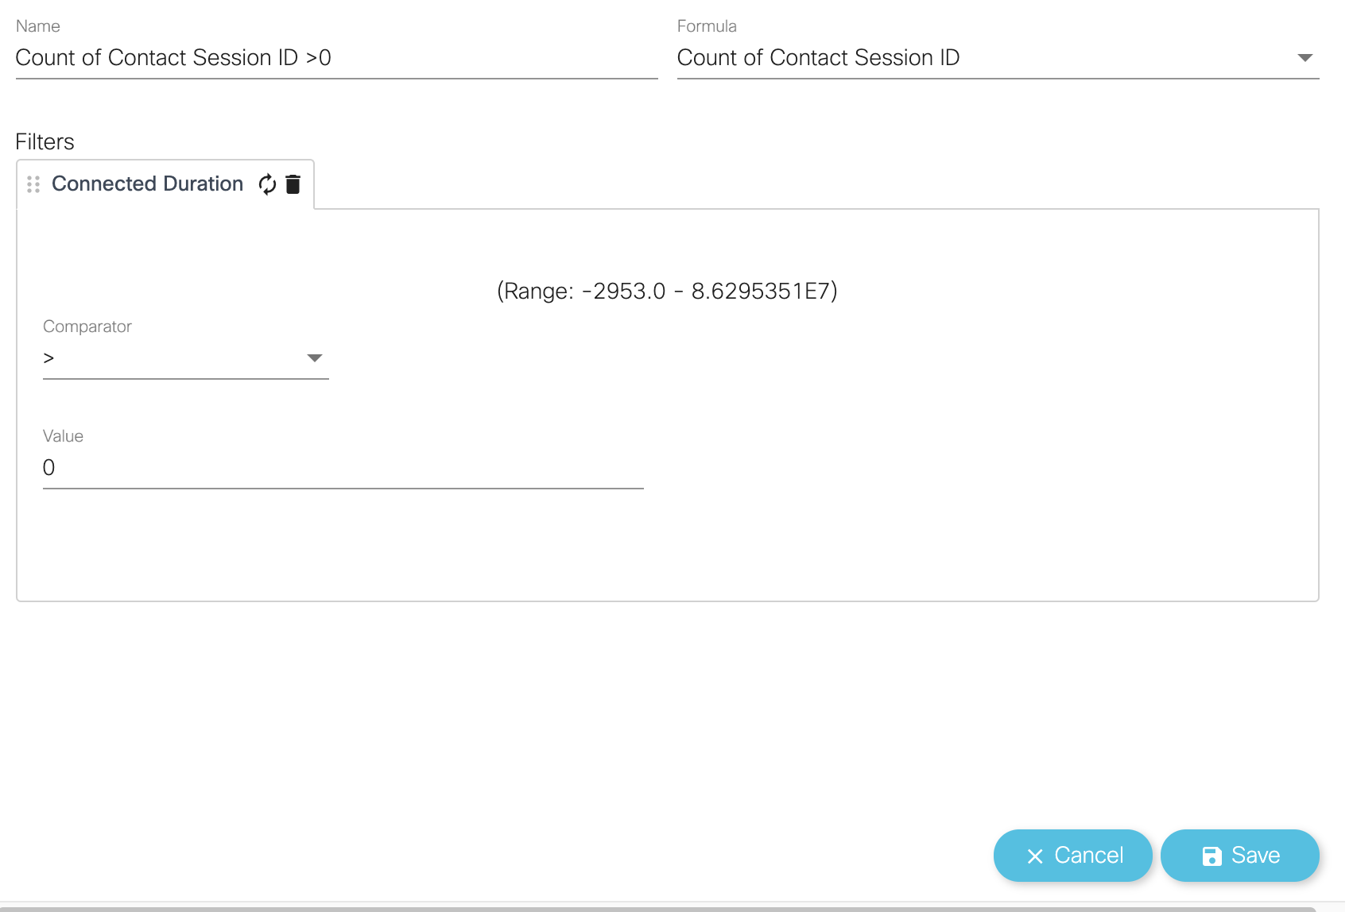
Filters
Filters are found on the left side of the visualization canvas/panel.
They set limits to the population of the data set.
Fields and Measures can be used as filters for the visualization.
Right click field or measure and Create Filter or drag to the filter panel.

Slide 20
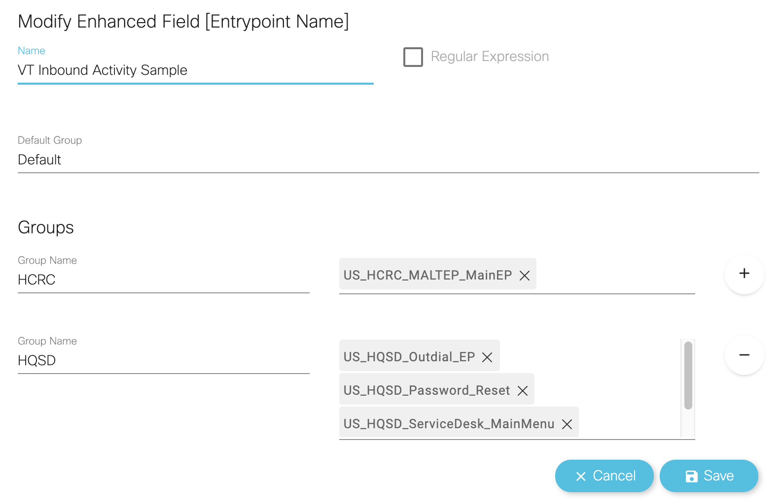
Enhanced Field
While creating or editing a visualization, users can create one or more enhanced fields to combine multiple values of a segmentation variable into one or more groups.
When the visualization is run, the values of all the segmentation variables in a group are combined into one row and the profiling variables for that visualization are computed for those segmentation values.

Slide 21
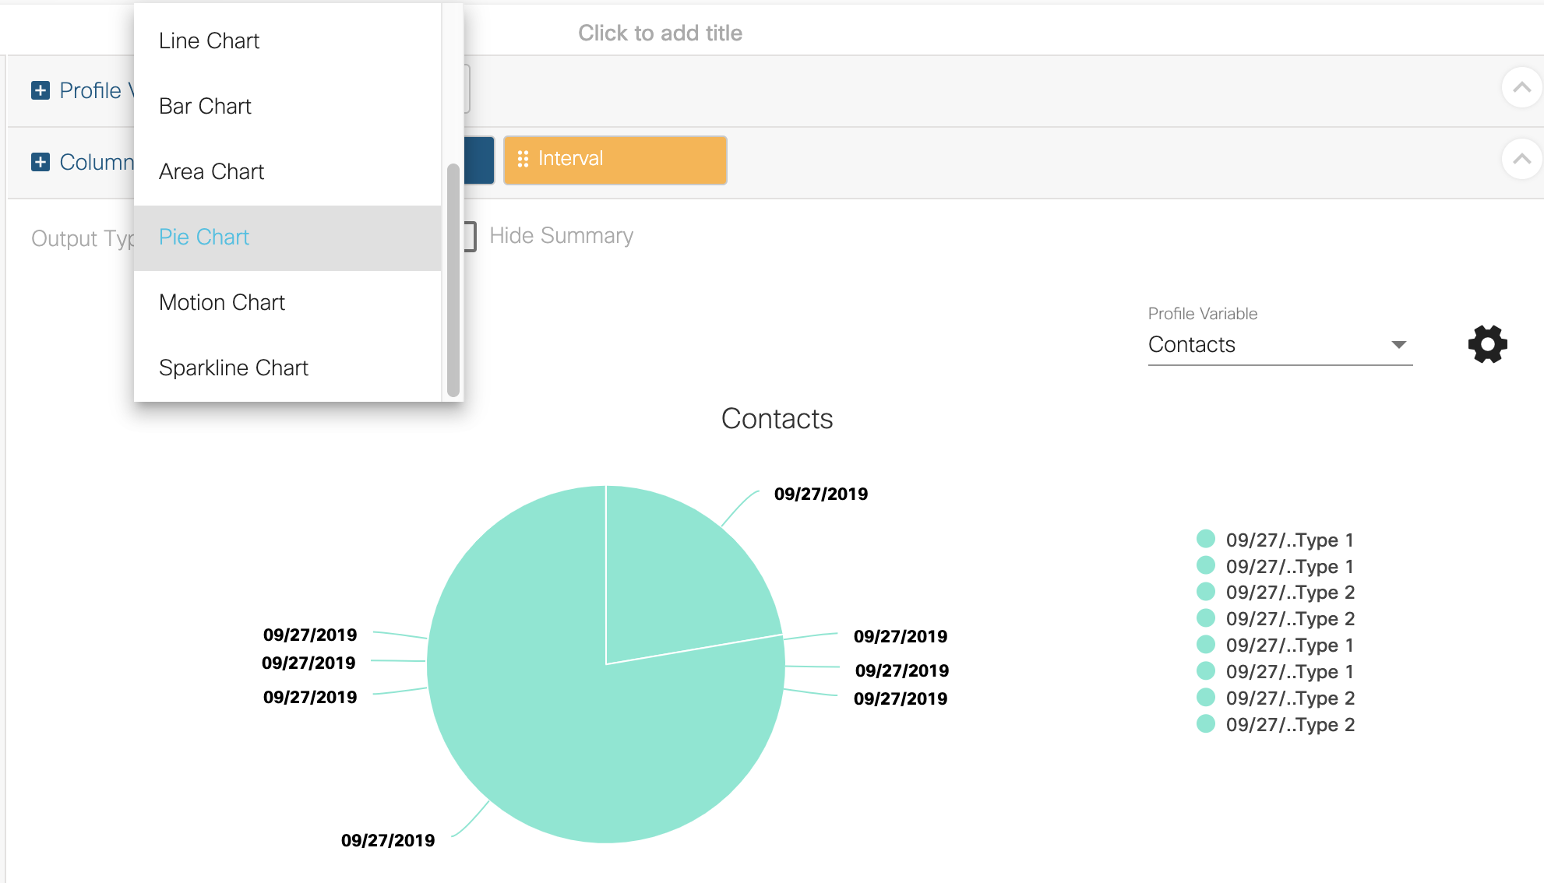
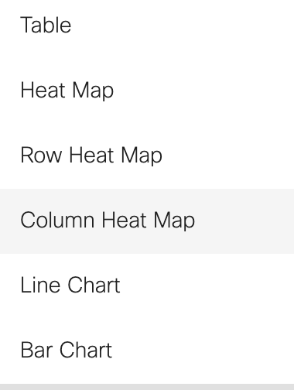
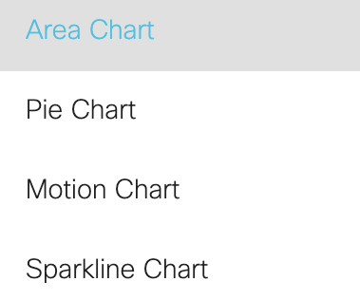
Data Output Formats
The data can be displayed as:

Slide 22
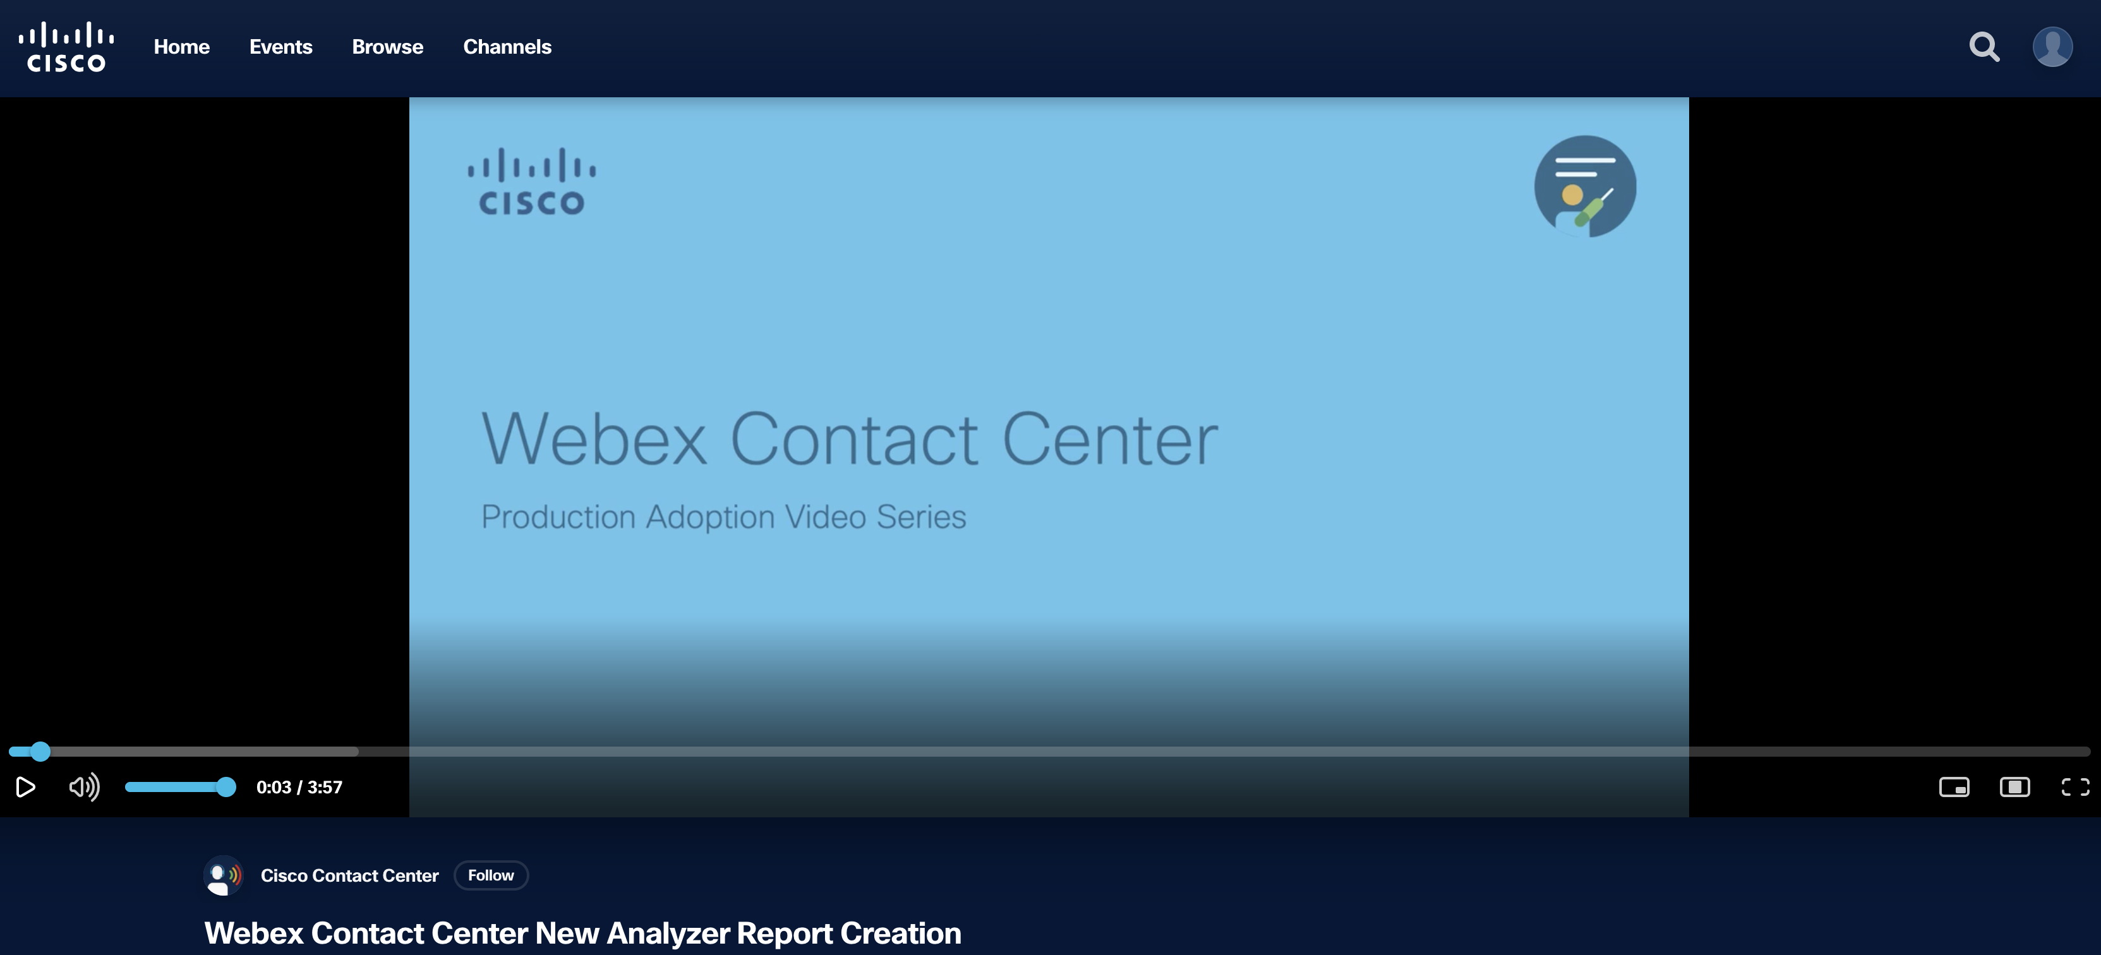
Creating a Visualization
https://video.cisco.com/video/6186649839001

Slide 23

Analyzer Scheduler

Slide 24
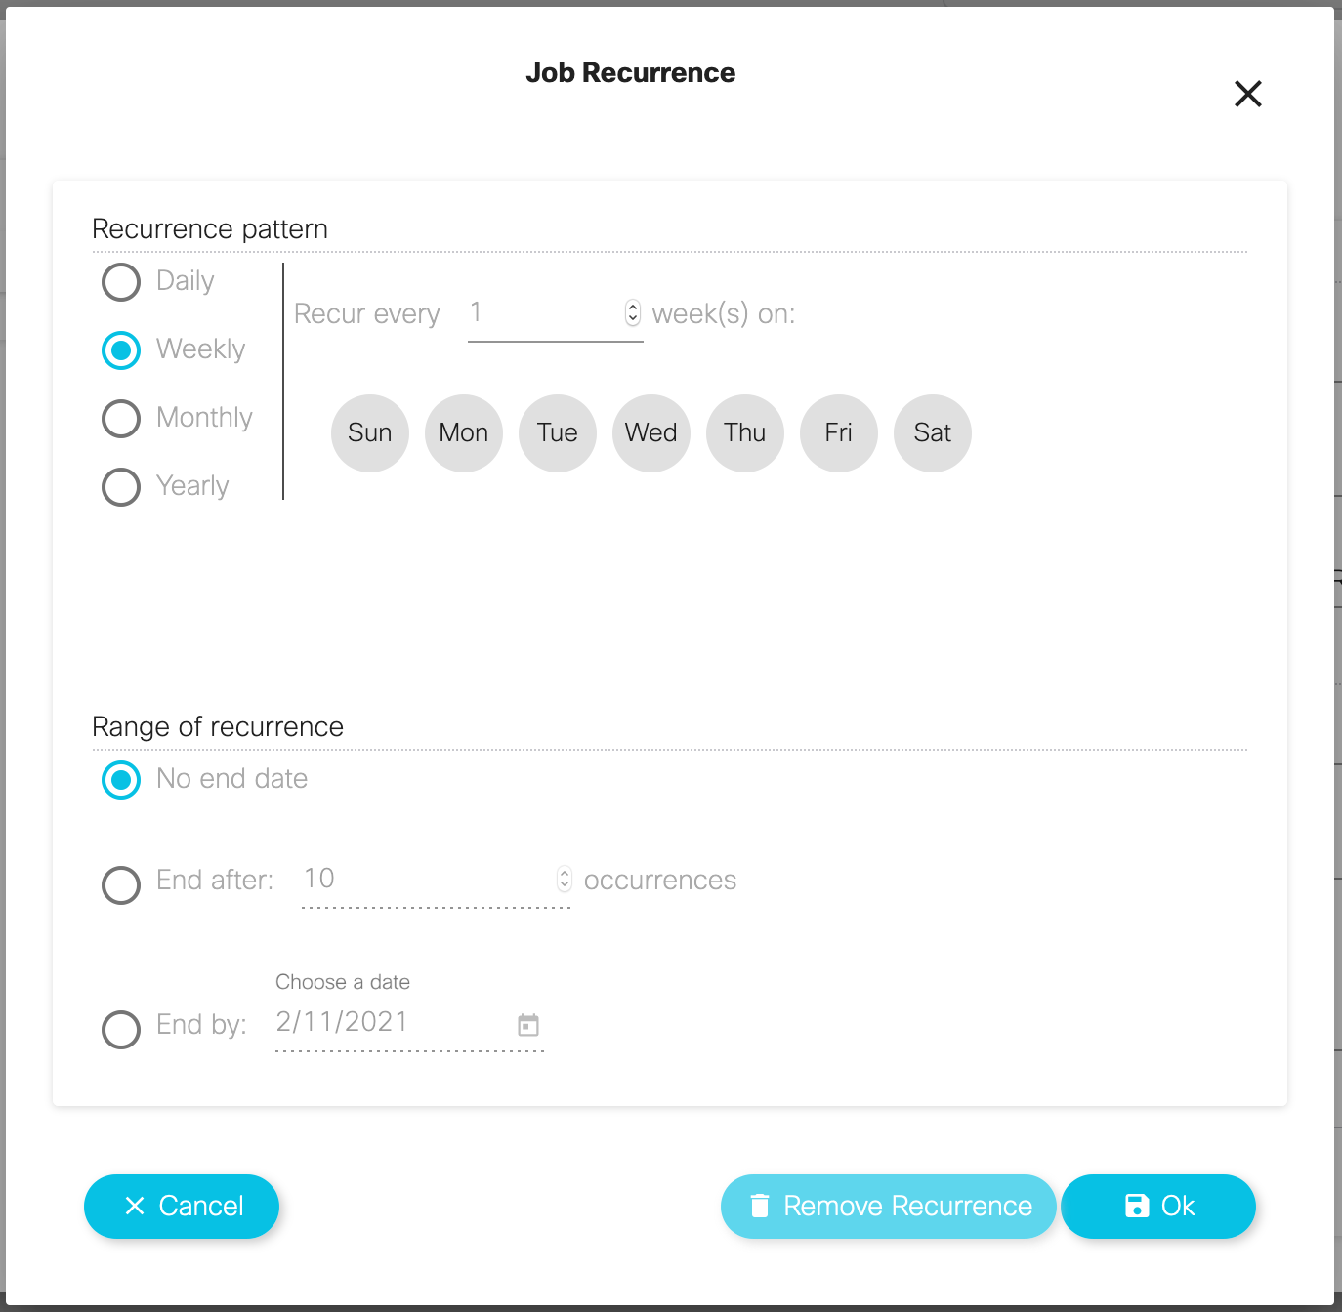
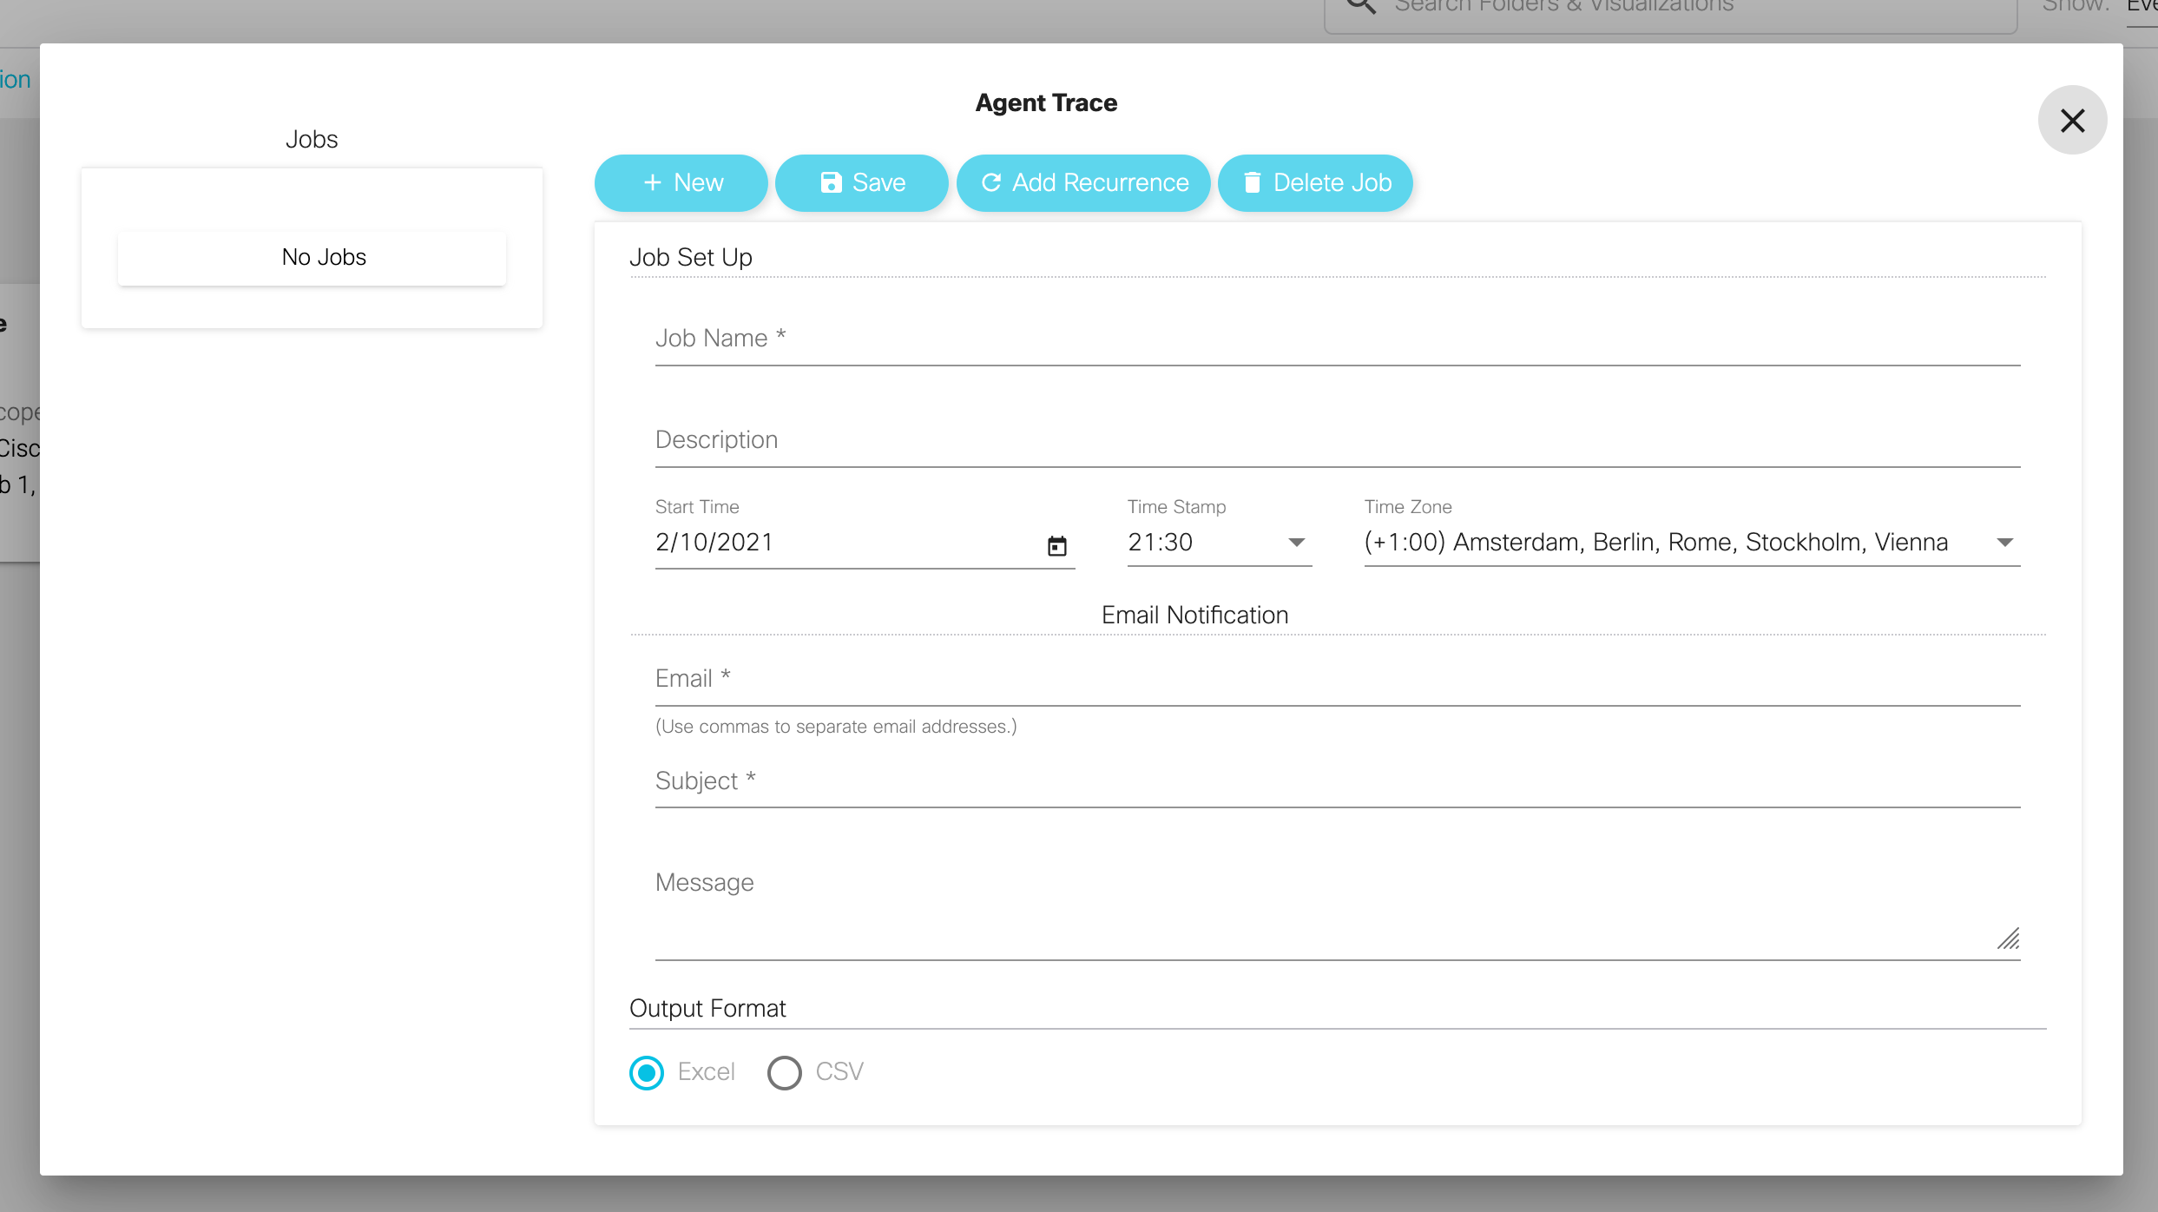
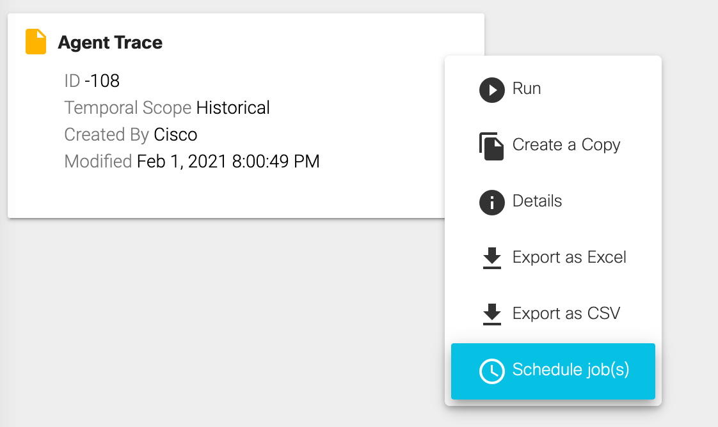
Analyzer Scheduler

Slide 25
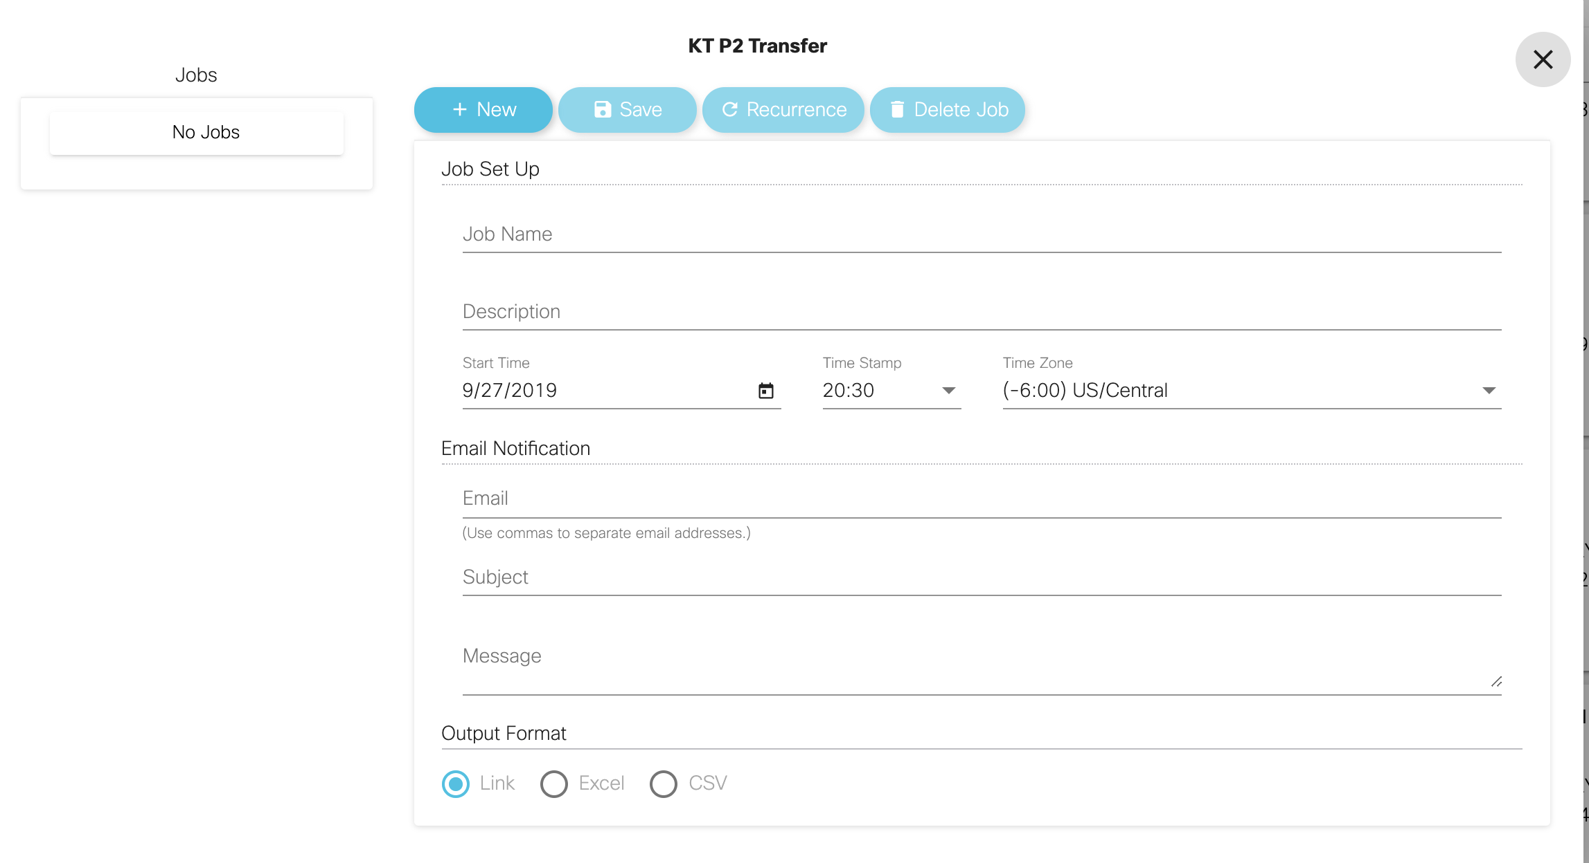
Analyzer Scheduler
Send the visualization or dashboard to any number of recipients in various formats
“The Job Scheduler” will allow the user to share the visualization with as many people as they want via an automated email job.
Advantages of the Scheduler:
Send visualizations periodically, on a recurring basis OR just one time (ad hoc)
Select the date, time, time zone and the recipients of the visualization
Complete the Subject and Message portion of the email and give the job a name and description (description is optional)
Output formats for visualizations
Excel file
CSV file
Link

Slide 26
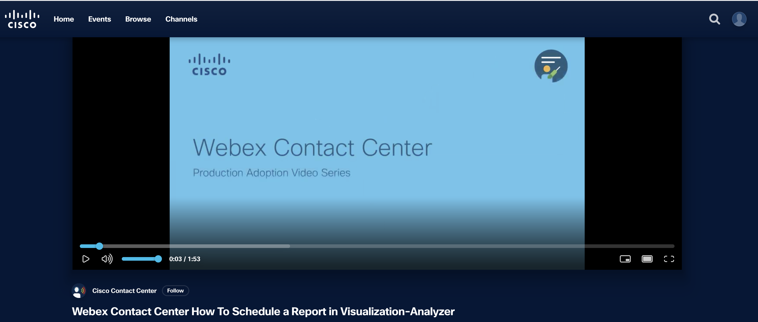
Scheduling a report
https://video.cisco.com/video/6186653328001

Slide 27

Stock Reports

Slide 28
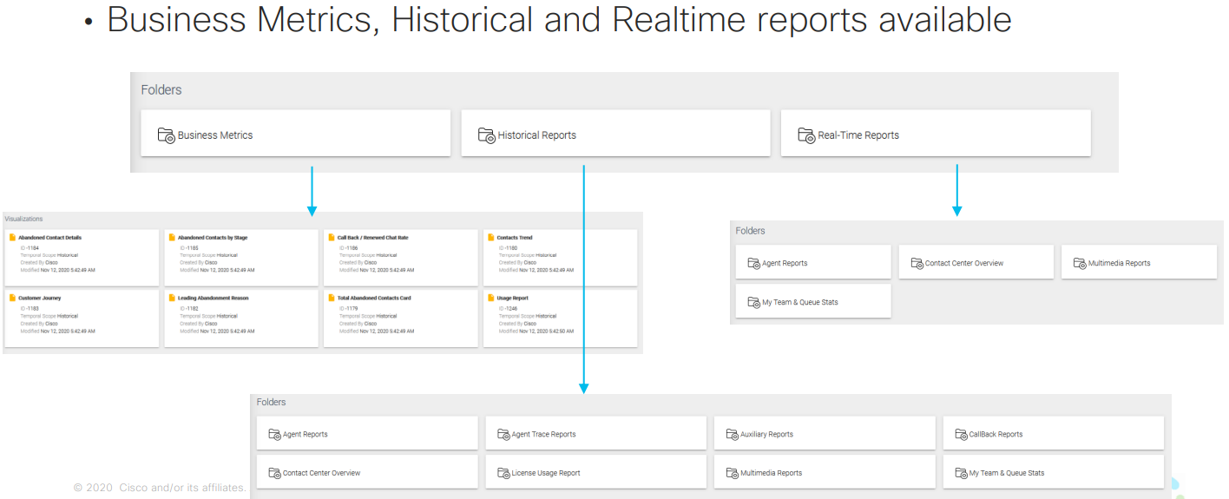
Visualizations
Analyzer guide

Slide 29
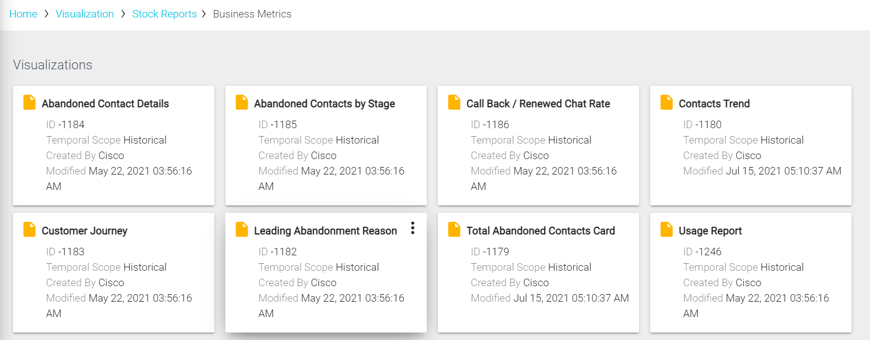
Business Metrics

Slide 30
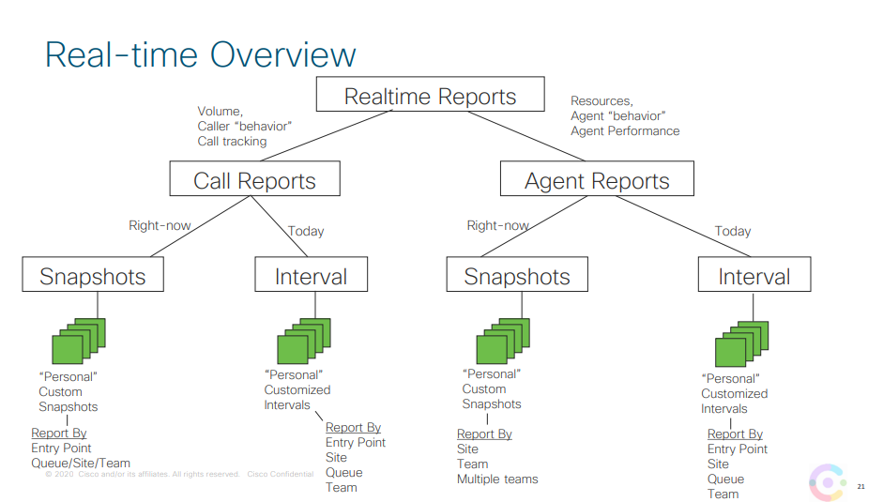

Slide 31
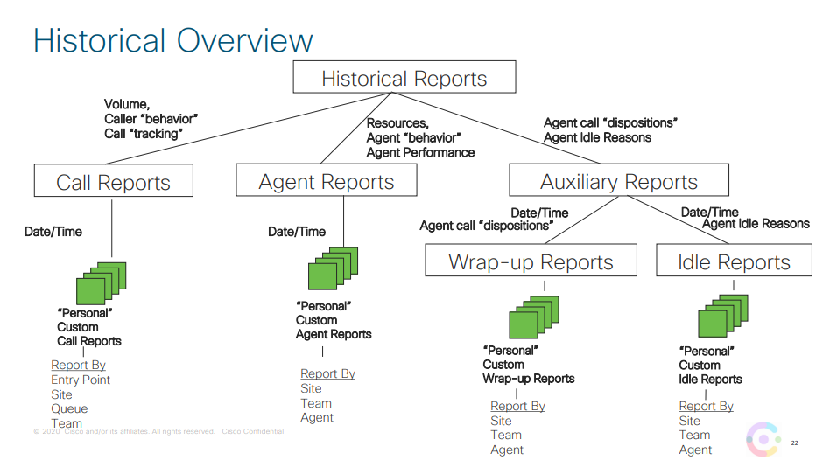

Slide 32
Analyzer Dashboards

Slide 33

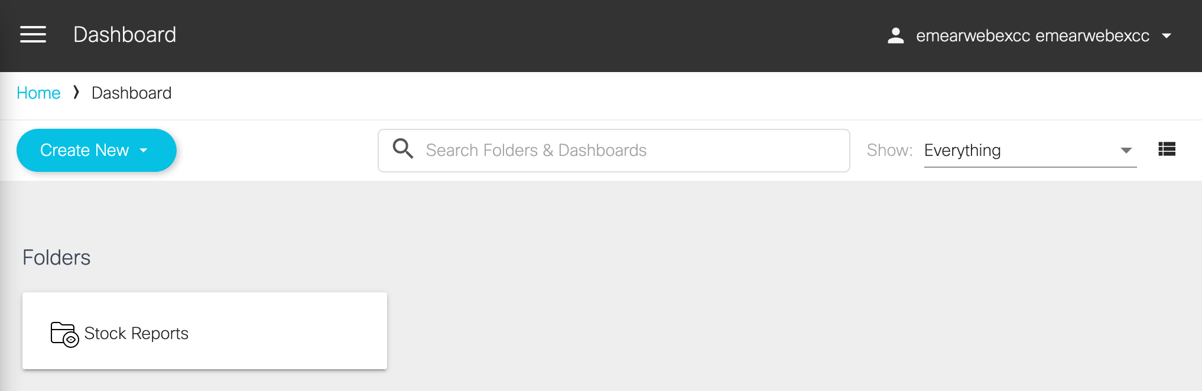
The Analyzer
Demo
Dashboards

Slide 34
Analyzer Dashboards

Slide 35
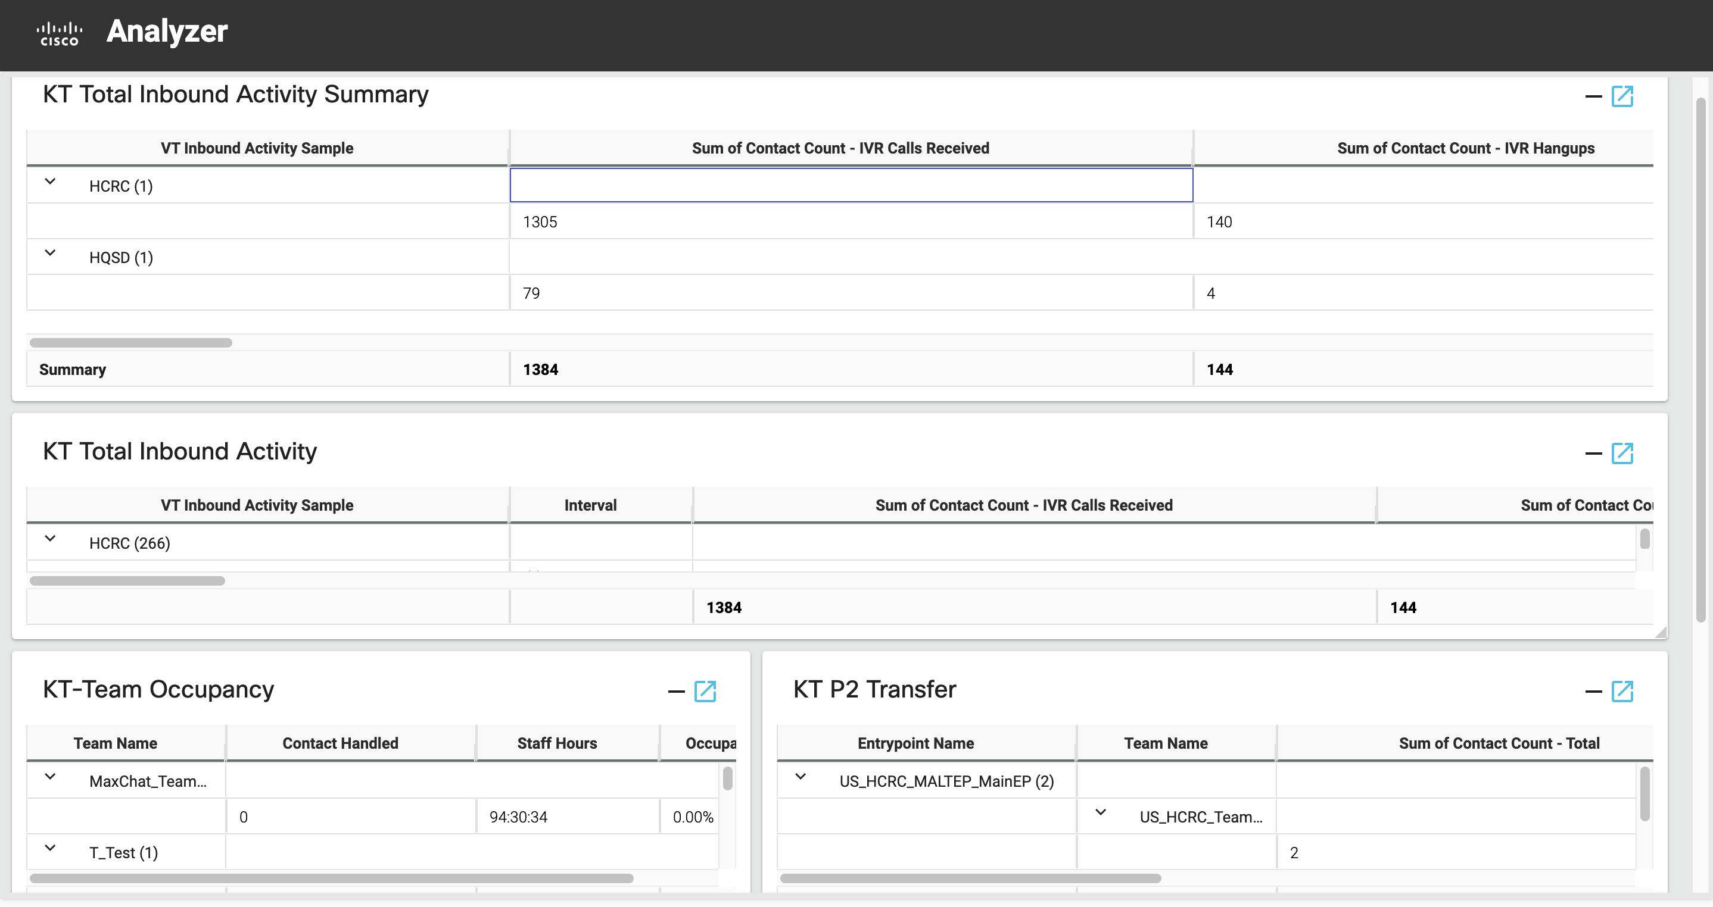
Analyzer Dashboards
Users can create a dashboard from the main page to create a custom visualization/reports canvas.
Dashboards allow more than one visualization to be presented at a time.
Pick visualizations from the panel on the left from any folder and drag to the canvas to edit.

Slide 36
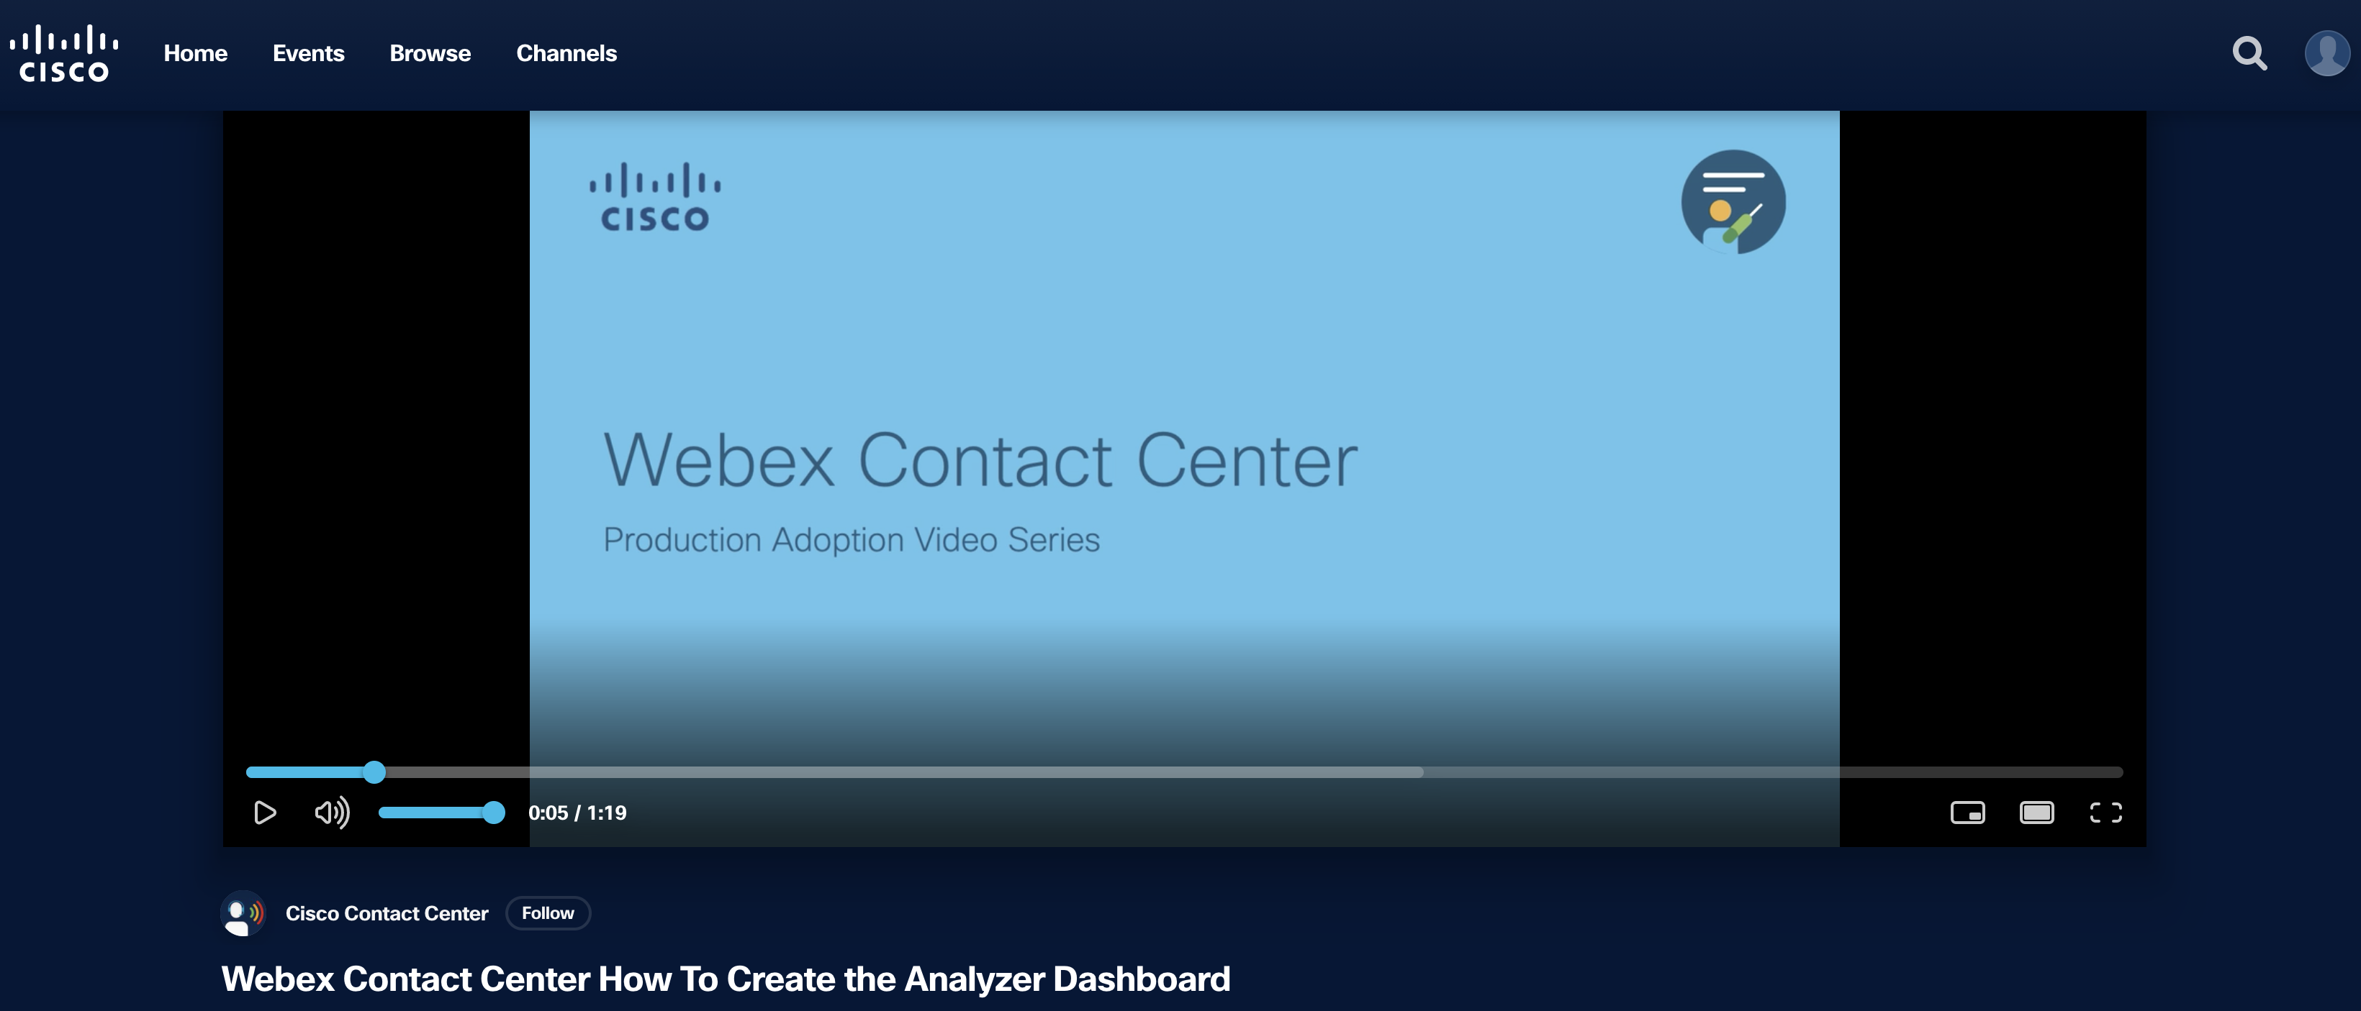
Creating a Dashboard
https://video.cisco.com/video/6186652858001

Slide 37
Questions?

